Slide 1

Conversion Rate Optimisation
Team Turquoise

Slide 2
Executive summary
Weekend dip no cause for concern: 0.05% difference in weekly vs weekday conversion rate follows industry standard.
Customers reluctant to manage baskets on mobile: Add to cart rate of just 4% across 2022 vs Desktop’s 11.7%. A/B test needed on tweaks to basket functionality on mobile.
High levels of cart abandonment overall: 89%% cart abandonment vs industry’s 70%. A/B testing on checkout process (e.g., reducing shipping cost and sign in restrictions)
Marketing timing is key for conversion: Conversion rate 49% higher on last day of month and peaks at 0.8% at 10am.

Slide 3
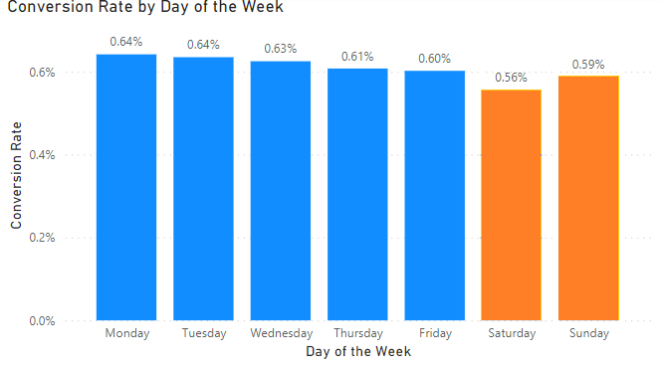
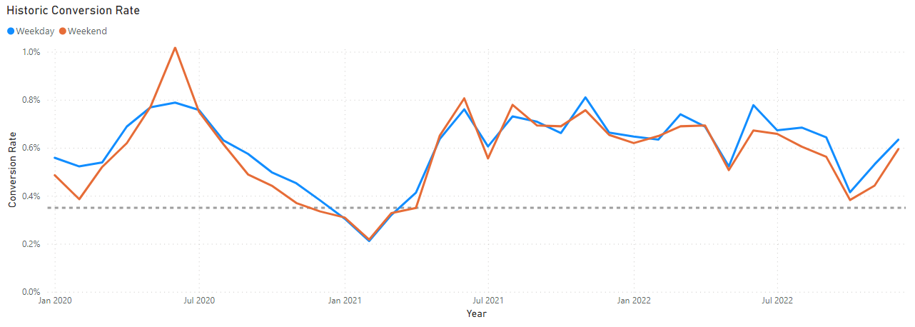
Weekend dip no cause for concern
Conversion rate 0.62% for weekdays, 0.57% for weekends – 8.06% decrease
Follows industry trends – Oribi study found 2.2% overall conversion rate dropping down to 2.1% on weekends
No cause for concern - weekend customer habits

Slide 4
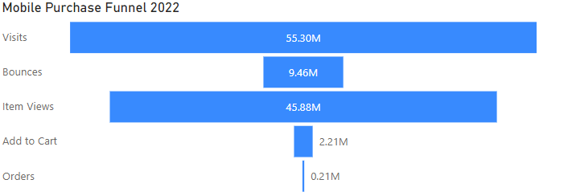
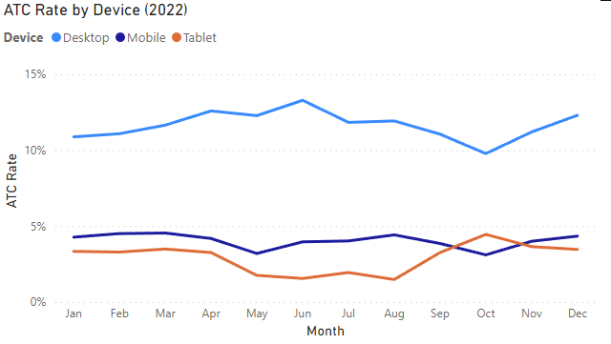
Managing baskets on mobile
Significant drop off in the funnel of our largest market, mobile, comes at the add to cart portion.
Add to cart rate of just 4% across 2022 vs Desktop’s 11.7%.
Improvement in managing basket will lead to greater conversion.
A/B testing on improvements to basket functionality on mobile:
Create a size profile for each customer.
Save shipping/payment information.
One-click ordering.
If we can improve ATC rate by X%, we will see a X improvement in…

Slide 5
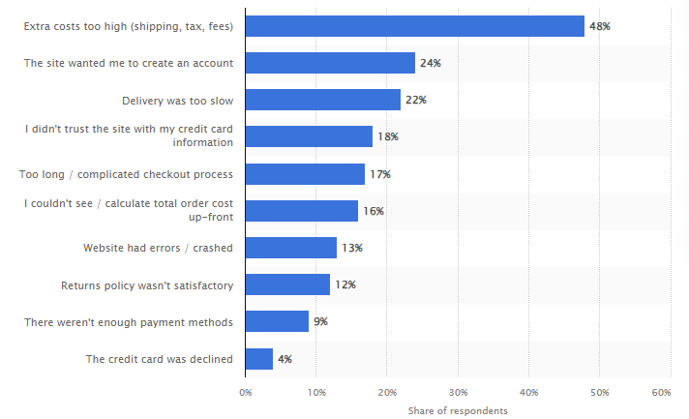
Why are customers abandoning carts?
Main reasons why consumers abandon their orders during the checkout process in 2022
(Source)

Slide 6
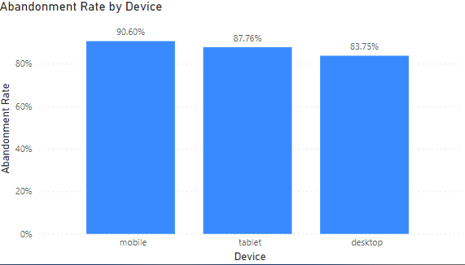
High levels of Cart Abandonment
High cart abandonment rates at 0.89% overall.
Industry standard for ecommerce cart abandonment is 70% (Source)
A/B testing on improvements to checkout process:
Reduce shipping costs: e.g., free shipping on orders over £50.
Offer guest checkout and sign in options with Google, Facebook, Apple.
A conservative 5% reduction in cart abandonment, would result in 11950 orders, at an AOV of £36.27, we would see a £433,426 improvement in revenue.

Slide 7
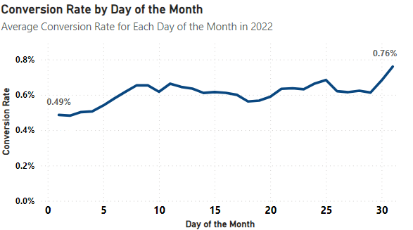
High End of month conversion rate:
Conversion rate 49% higher on last day of month compared to the first in 2022
Due to pay day cycles, monthly budgets or expiring promotions
Recommendations:
A/B testing for marketing and promotions timing
Email reminders and targeted advertising for abandoned carts from earlier in month
New product releases at end of the month
Impacts:
Increase sales and conversion rate
Higher return on investment for marketing

Slide 8
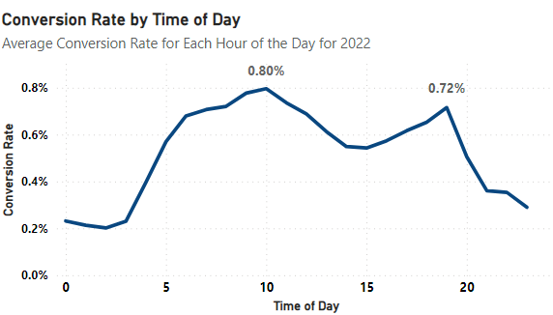
Morning conversion rate peak:
Conversion rate 31.1% above average at 10am and 18% above average at 7pm for 2022 (daily average 0.61%)
High morning/early afternoon CR due to commutes, limited physical shopping opportunities, delivery deadlines
Recommendations:
A/B testing for marketing and promotions timing
Email/notification reminders/targeted advertising at peak times
Flash sales weekday mornings/lunch times and in the evening
Impacts:
Increase sales and conversion rate
Higher return on investment for marketing

Slide 9
Potential future analysis:
Survey customers as to why they abandoned.

Slide 10
Conclusion:
Weekend dip isn’t a concern but should be monitored.
Test improvements to basket functionality on mobile.
Test improvements to checkout process.
Test marketing and promotions timing.

Slide 11
Any questions?

Slide 12
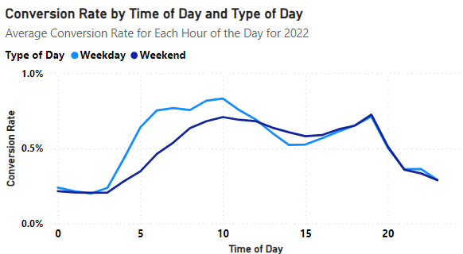
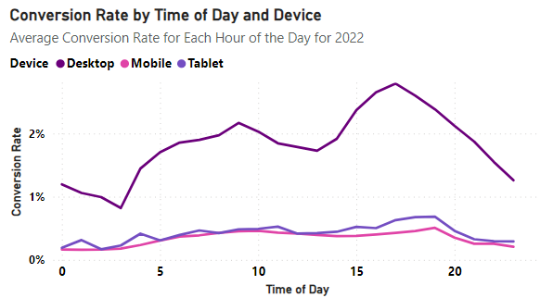
Conversion rate by Time of Day

Slide 13
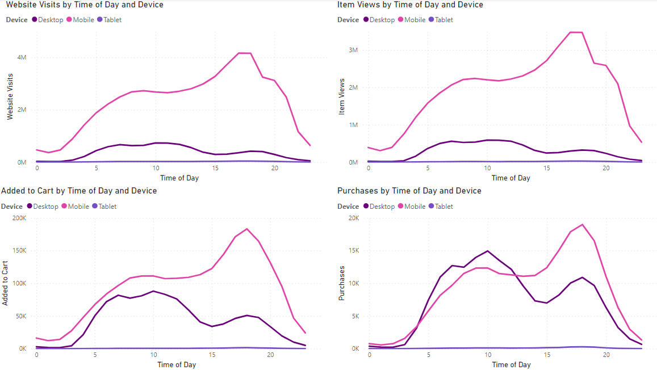
Funnel by Time of day

